Slide 1
How to Build a
Chrome Extension
Dhruv Patel

Slide 2
What To Know
Web Development Suite
HTML
CSS
Javascript
Understand how they interact with each other.

Slide 3
Exercise Files
Go to the following link:
https://github.com/HackCU/workshops
Download it and unzip on your pc.
Open it in your favorite editor

Slide 4
How to load an extension
Open Google Chrome
Open “chrome://extensions”
Turn on Developer Mode
Load Unpacked
Click on the folder. Unzipped version.

Slide 5
Manifest.JSON
This file provides all the specifications for the extension. This is how the extension loads up.
Descriptive Properties:
Name, Description, Version, Manifest Version, Icons
Permissions:
Storage: no backend
Clipboard Read/Write: Access to clipboard
Declarative Content: Only activates under conditions
Context Menu: Allow for right click actions
Others can be found on tinyurl.com/experms

Slide 6
Manifest.JSON
Action
Browser Action: Works everywhere
Page Action: Works under specific conditions set up by declarative content.
Files To Run
Background, Popup, and Options

Slide 7
Popup
Load the extension and see how the popup interacts.
You should have one button.

Slide 8
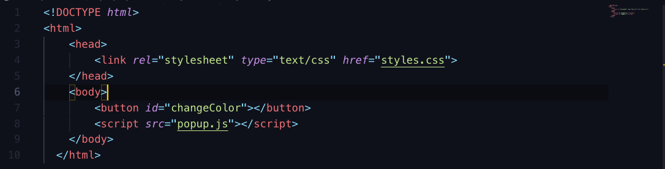
Popup

Slide 9
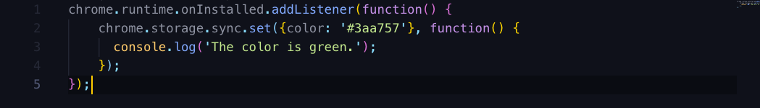
Background

Slide 10
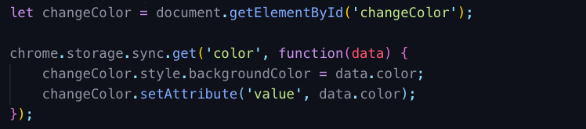
Popup.js

Slide 11
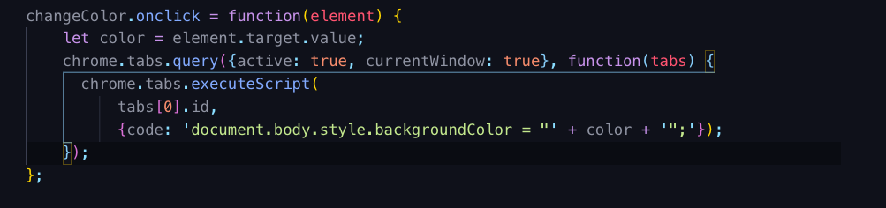
Popup.JS

Slide 12
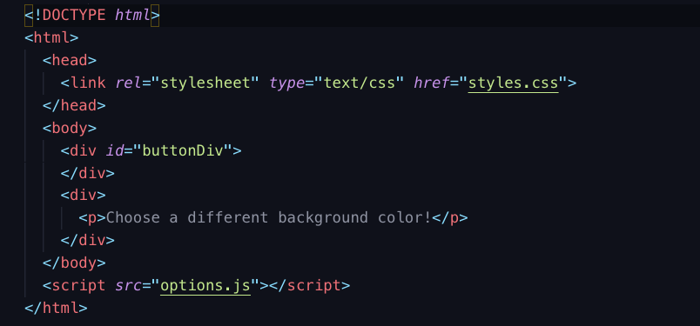
Options.html

Slide 13
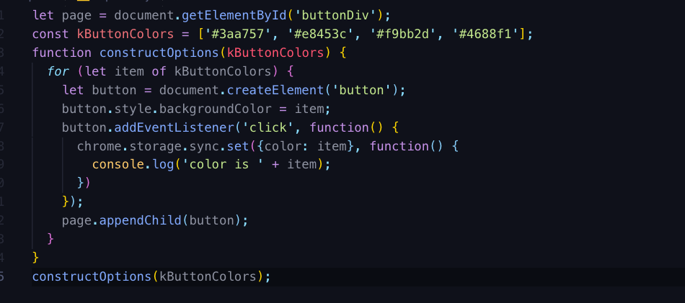
Options.js

